Slide 1
Process discovery:
Inductive Miner
Sander Leemans
D. Fahland
W.M.P van der Aalst

Slide 2


Process discovery
system
log
process model

Slide 3


Quality
System behaviour
Sound
Simple
Complete log
Recorded log
fast
Fitting
Precise
=
Notes:
Log
Discover model

Slide 4
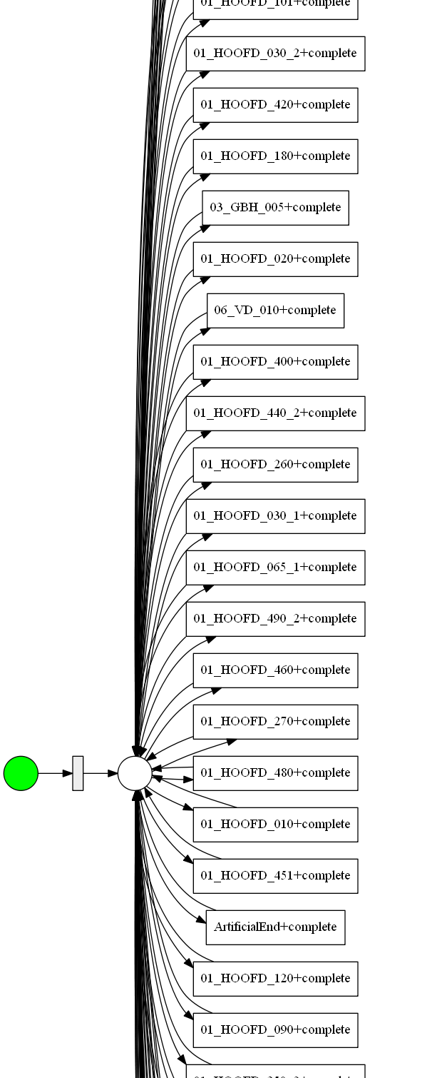
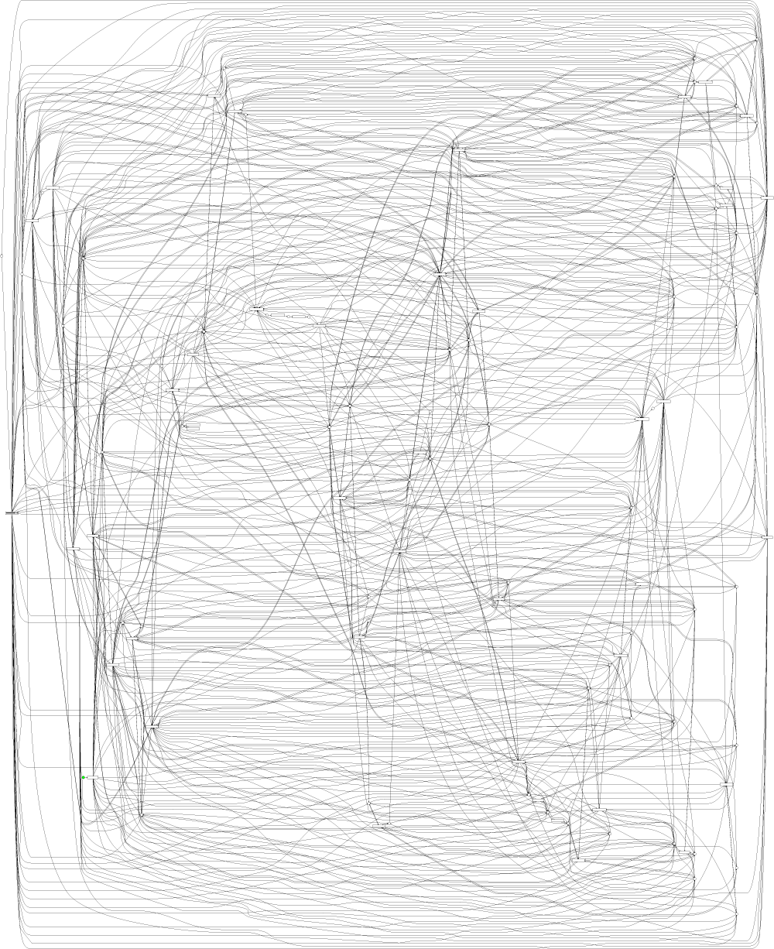
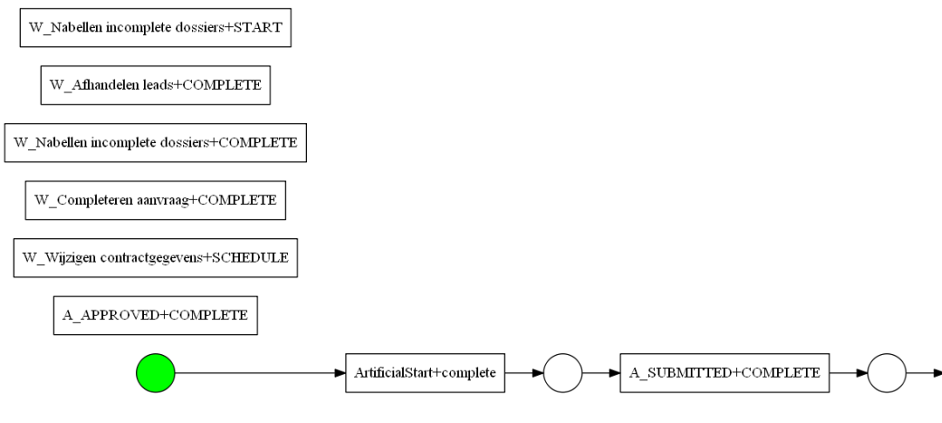
Results with incomplete logs
not fitting
not sound
not simple
not sound
Flower model
not precise
α
ILP
Heuristics Miner
Evolutionary Tree Miner
not fitting
not sound
not fast

Slide 5
Outline
System behaviour
{<a,b,c>,
<a,c,b>,
<a,d,e>,
<a,d,e,f,d,e>}
=

Slide 6
Block-structured Petri nets
a
τ
τ
b
τ
c
d
τ
x
e
/\
a
b
→
e
c
d
Notes:
Activities
Sequence
Loop
Parallel
Exclusive choice
Sound

Slide 7
Outline
System behaviour
=

Slide 8
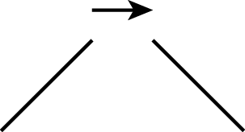
Divide & conquer
{<a,b,c>,
<a,c,b>,
<a,d,e>,
<a,d,e,f,d,e>}
a
{<a>,
<a>,
<a>,
<a>}
{<b,c>,
<c,b>,
<d,e>,
<d,e,f,d,e>}
recurse
recurse

Slide 9
Finding operator
b
{<a,b,c>,
<a,c,b>,
<a,d,e>,
<a,d,e,f,d,e>}
a
{<b,c>,
<c,b>,
<d,e>,
<d,e,f,d,e>}
a
c
d
e
f
Find cut in directly-follows graph
Sequence: edges crossing one-way only
recurse

Slide 10
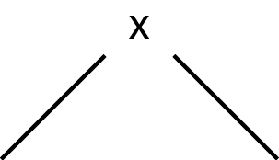
recurse …
{b,c}
{d,e,f}
a
x
{<b,c>,
<c,b>,
<d,e>,
<d,e,f,d,e>}
{
{
,
}
<b,c>
<c,b>
,
,
,
{<b,c>,
<c,b>}
{<d,e>,
<d,e,f,d,e>}
b
{
<d,e>
<d,e,f,d,e>
,
}
c
}
d
e
Exclusive choice: no crossing edges
f

Slide 11
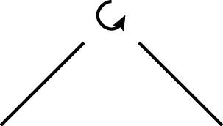
… one more recursion …
{d,e}
{f}
a
x
>,
>,
>}
d,e
{<
<
<
{<
>,
{<b,c>,
<c,b>}
{<d,e>,
<d,e,f,d,e>}
d,e
{< >}
<
,
d,e
f
>}
,
{<d,e>}
{<f>}
f
d
e
d
e
Loop: identify body and loopback parts
(assumption: start/end activities disjoint)
f

Slide 12
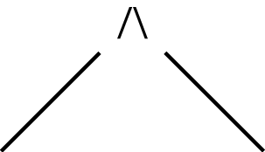
… last recursion
{b}
{c}
a
x
{<
<
>
>}
b
c
>,
>}
>
>}
{<
<
,
,
{<
<
{<b,c>,
<c,b>}
c
b
b
c
f
{<b>}
{<c>}
b
d
e
Parallel: all possible crossing edges
c

Slide 13
Result
b
τ
τ
a
c
a
x
τ
d
e
τ
f
b
c
f
d
e

Slide 14
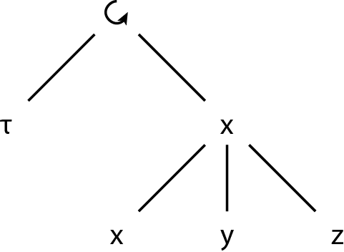
No cut
x
a
x
y
x
z
y
z
b
c

Slide 15





Inductive Miner
?
Divide activities
Select operator
  Else: flower model
Split log
Recurse on splitted logs
{a,b}
{c,d}
?
{c}
{d}

Slide 16
Outline
System behaviour
=

Slide 17


Rediscoverability
System behaviour
Complete log
= (language equivalent)
= (normal form)
Block-structured with
Start\end activities of loop disjoint
No duplicate activities
No silent activities (τ)
Directly-follows graph complete
Noise-free
x
Notes:
Log
Discover model

Slide 18

Incomplete logs
System behaviour
Complete log
Sound
Simple
Incomplete log
polynomial
Fitting
Most precise
(by framework; bring your own operator)

Slide 19
Future Work
Generalise
  Block-structured
  Start\end activities of loop must be disjoint
  No duplicate activities
  No silent activities (τ)
  Directly-follows graph complete
  Noise-free
x

Slide 20
You have been watching
System behaviour
Complete log
Sound
Simple
Incomplete log
polynomial
Fitting
Most precise
(by framework; bring your own operator)

